Slide 1
Clock Around the Clock: Time-Based Device Fingerprinting
Presented by Haofan Zheng

Slide 2
Background

Slide 3
Device Fingerprint
A device fingerprint is information collected about a remote computing device for the purpose of identification. Fingerprints can be used to fully or partially identify individual devices. [2]

Slide 4
Applications
Device authentication
Software license binding
Attacker identification
Wireless network identification

Slide 5
Fingerprint in Hardware Level
Physical Functions
  Physical One-Way Functions [5]
    Easy to evaluate, but difficult to invert, like hash function.
  Physical Unclonable Functions (PUF) [6]
    A complex integrated circuit (IC) generates unique challenge-response pairs, based on the variation of each IC.
  Building Secret Key in IC [7]
    Based on PUF

Slide 6
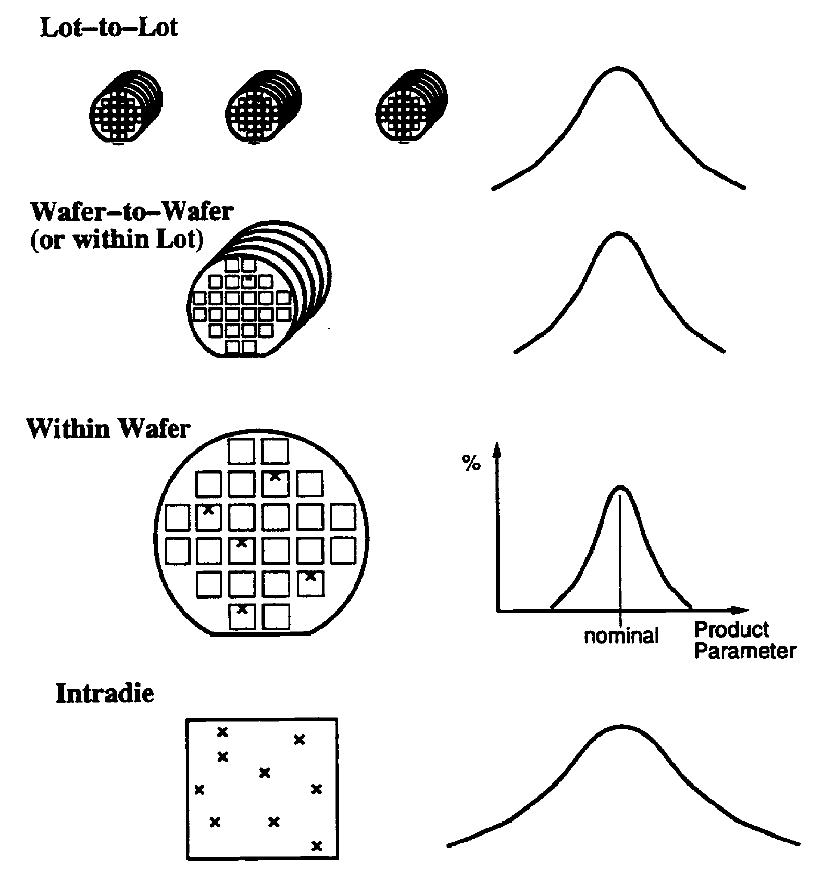
Manufacturing Variation
Variation in Microelectronics Manufacturing, which impacts performance and reliability. [3]
  In CPU manufacturing, within-die fluctuations primarily impact the maximum clock frequency [4]
  An example for variation would be the resist thickness across the wafer

Slide 7
Web Device Fingerprinting
Website server computes the fingerprint of the visitor.

Slide 8
Existing Techniques
Attribute-based Device Fingerprint
  List of fonts, UserAgent string, screen resolution, …
Hardware-level Device Fingerprint
  Canvas Fingerprint
  Audio Fingerprint
  WebGL Fingerprint
  Battery API Fingerprinting
  …

Slide 9
Canvas FP [8]
HTML5 provides programmatic drawing surface, with tag <canvas>.
Render text and WebGL scene to a <canvas> element.
Different systems produce different output.
Output is a Base64 encoding PNG image, and then, the Base64 is hashes to form fingerprints.
The form of fingerprints: Hash values.

Slide 10
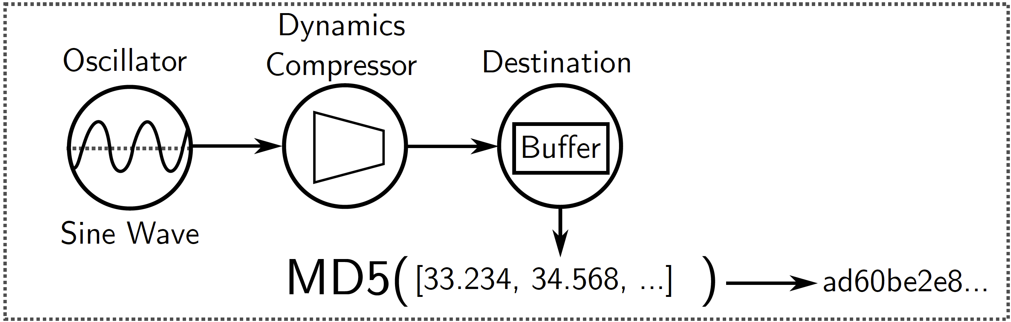
Audio FP [9]
Process an audio signal.
Different machines or browsers may generate slightly different result, due to hardware or software differences.
The output is hashed to form the fingerprint.
The form of fingerprints: Hash values.

Slide 11
WebGL FP [10]
Improved version of Canvas FP.
Much more features are considered
  Modified old features
    Screen resolution ratio, number of CPU virtual cores, AudioContext (Audio FP), and list of fonts.
  Newly proposed atomic features
    Line, curve, anti-aliasing, vertex shader, fragment shader, alpha channel, image coding, and installed writing scripts.
  Newly proposed composite features
    3D modeling, lighting and shadow, camera, and clipping planes.

Slide 12
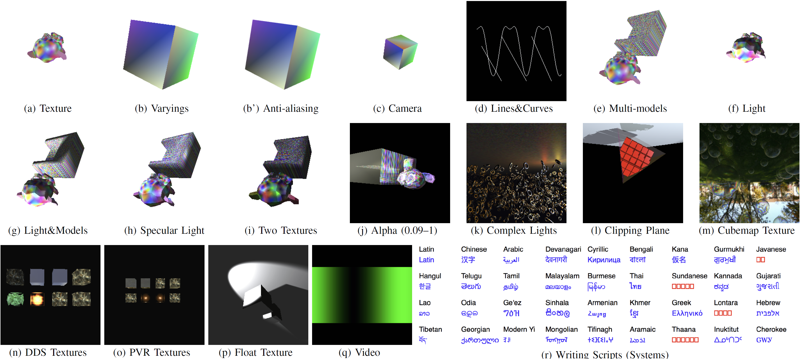
WebGL FP [10]
The form of fingerprints: Hash values.

Slide 13
Overall Design

Slide 14
CryptoFP
Based on the variation of oscillators (quartz crystals)
Enough amount of instructions to amplify the difference
A separate clock is used to measure execution time
Advantages:
  Homogeneous discrimination
  Resilience to evasion
  Resilience to changes (comparing to stability)

Slide 15
Threat Model
Fingerprint requesting entity could be an arbitrary website containing JavaScript code
CryptoFP is implemented in JavaScript code
There could be numerous layers between JavaScript code and the CPU instruction

Slide 16
Potential Use Cases
Advertisers or tracking companies want to obtain user’s browsing history
Website with strong authentication

Slide 17
Host-Based Fingerprint
A native version of CryptoFP, which is implemented in C.
It is used to tune the algorithm.
Baseline for comparison with the web-based version.
Implemented before web-based version.

Slide 18
Fingerprint Generation

Slide 19
Fingerprint Generation
Function(0);
Function(1);
logTime
Function FPGeneration(n,m)
i ← 1;
fp ← f loat[][] of size n × m;
while i ≤ m do
j ← 1;
while j ≤ n do
startTime ← GetCurrentTime();
Function(j);
endTime ← GetCurrentTime();
logTime ← endTime − startTime;
fp[j][i] ← logTime;
j ← j + 1;
end
i ← i + 1;
end
return fp;
0.1
0.12
0.14
m rows
0.1
0.12
0.13
0.1
0.12
0.13
n columns

Slide 20
Fingerprint Generation
Function(j);
Function FPGeneration(n,m)
i ← 1;
fp ← f loat[][] of size n × m;
while i ≤ m do
j ← 1;
while j ≤ n do
startTime ← GetCurrentTime();
Function(j);
endTime ← GetCurrentTime();
logTime ← endTime − startTime;
fp[j][i] ← logTime;
j ← j + 1;
end
i ← i + 1;
end
return fp;
Must generate stable fingerprints
  Not too complex
  Not too simple
  Same procedure from machine to machine
Choices for C++ Implementation
  std::string::compare
  std::regex
  std::hash
Choices for Web Implementation
  Cryptography API, especially, generateRandomNumbers
Value j can point to different configuration to the execution.

Slide 21
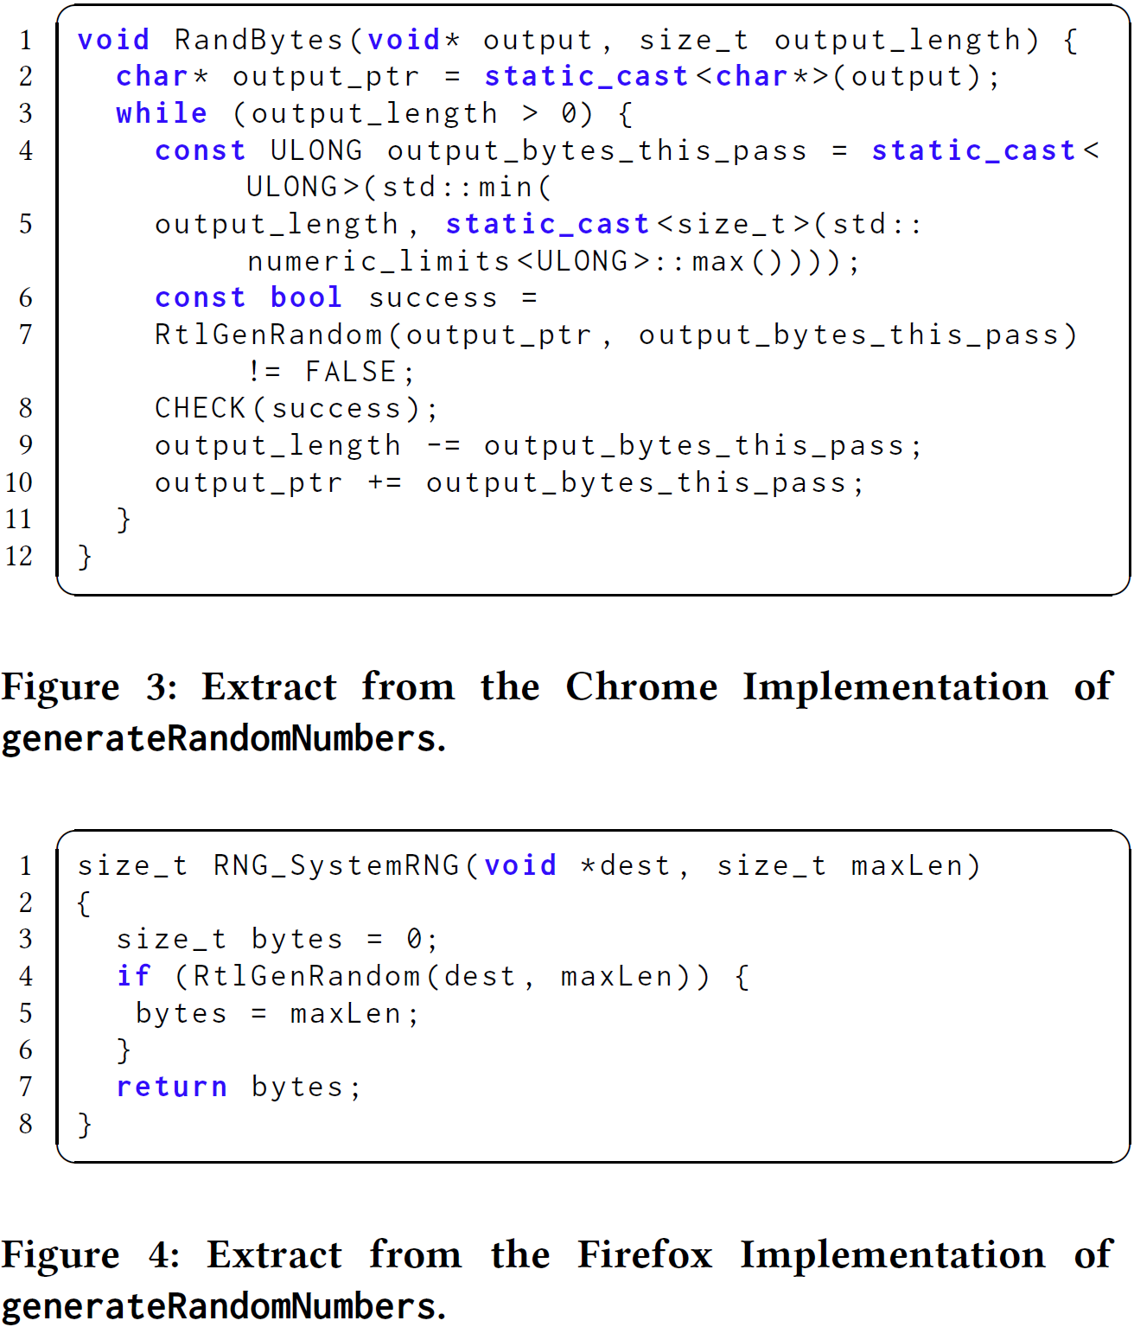
Fingerprint Generation
Function(j);
Function FPGeneration(n,m)
i ← 1;
fp ← f loat[][] of size n × m;
while i ≤ m do
j ← 1;
while j ≤ n do
startTime ← GetCurrentTime();
Function(j);
endTime ← GetCurrentTime();
logTime ← endTime − startTime;
fp[j][i] ← logTime;
j ← j + 1;
end
i ← i + 1;
end
return fp;

Slide 22
Fingerprint Generation
n x m
Function FPGeneration(n,m)
i ← 1;
fp ← f loat[][] of size n × m;
while i ≤ m do
j ← 1;
while j ≤ n do
startTime ← GetCurrentTime();
Function(j);
endTime ← GetCurrentTime();
logTime ← endTime − startTime;
fp[j][i] ← logTime;
j ← j + 1;
end
i ← i + 1;
end
return fp;
Considerations
  Generation time
  Discrimination capabilities
  Function used
Based on their test,
n = 1000 and m = 50
is sufficient.

Slide 23
Fingerprint Comparison

Slide 24
Fingerprint Comparison
The fingerprint is a matrix, which cannot be compared like hash values.
Executions on the same machine may generate two matrices with some different values.

Slide 25
Fingerprint Comparison
0.1 | 0.12 | 0.14
0.1 | 0.12 | 0.13
0.1 | 0.12 | 0.13
0.1 | 0.12 | 0.14
0.11 | 0.12 | 0.14
0.1 | 0.12 | 0.13
0.1 | 0.12 | 0.13
Mode:
2
3
1
6

Slide 26
Fingerprint Comparison
0.1 | 0.12 | 0.14
0.1 | 0.12 | 0.13
0.1 | 0.12 | 0.13
0.1 | 0.12 | 0.14
0.11 | 0.12 | 0.14
0.1 | 0.12 | 0.13
0.1 | 0.12 | 0.14
Mode:
3 | 3 | 1
7

Slide 27
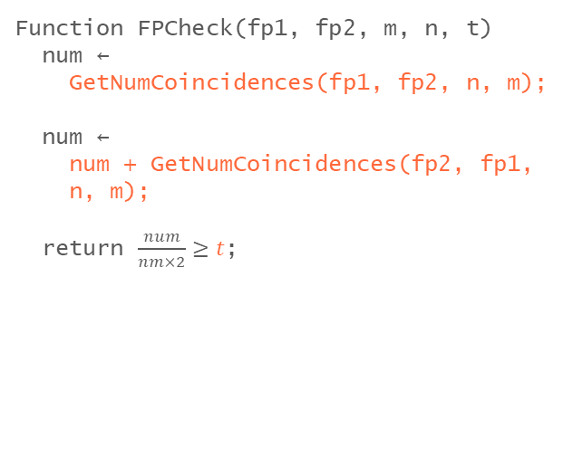
Fingerprint Comparison
t
Function FPCheck(fp1, fp2, m, n, t)
num ←
GetNumCoincidences(fp1, fp2, n, m);
num ←
num + GetNumCoincidences(fp2, fp1,
n, m);
return $\frac{num}{nm×2}≥t$;
The threshold that determines if two fingerprint match based on the number of matches value in matrices.
Tuned by experiments with a subset of different computers
Result: t = 0.5

Slide 28
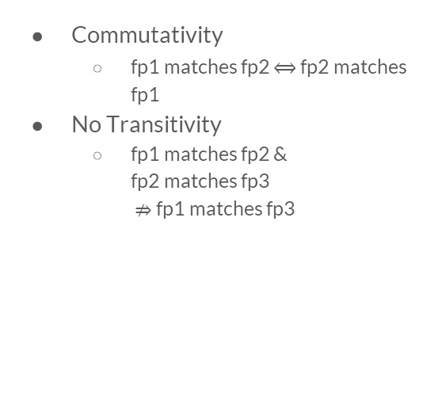
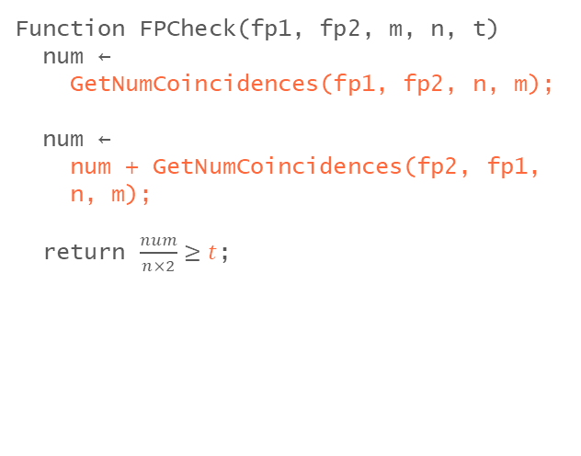
Fingerprint Comparison
Function FPCheck(fp1, fp2, m, n, t)
num ←
GetNumCoincidences(fp1, fp2, n, m);
num ←
num + GetNumCoincidences(fp2, fp1,
n, m);
return $\frac{num}{n×2}≥t$;
Commutativity
  fp1 matches fp2 $⟺$ fp2 matches fp1
No Transitivity
  fp1 matches fp2 &
  fp2 matches fp3
  $⇏$ fp1 matches fp3

Slide 29
Evaluation

Slide 30
Fingerprint Assessment
Discrimination Power
  Produce different fingerprints for different targets
Efficiency
  Fingerprints generation time & comparison time
Stability
  Always produce the same fingerprint for same target

Slide 31
Fingerprint Assessment
Homogeneous Discrimination
  Produce different fingerprints for different targets in the same homogeneous family
Resilience to Evasion
  Known technique to avoid fingerprint generation or reduce the consequences of fingerprint generation.
Resilience to Change
  Fingerprint remain stable over time
  Different from stability

Slide 32
Methodology
For Discrimination Power
  Compare each fingerprint with the rest of fingerprints in the test set.
  For example, assuming there are 6 machines, A, B, C, D, E, and F.
    A matches no one – 0 match.
    B matches C – 1 match
    C matches B, E and F – 3 matches
    D matches E – 1 match
    E matches C and D – 2 matches
    F matches C – 1 match
Number of Matches | Count | Percentages
0 | 1 | ~16.7%
1 | 3 | 50%
2 | 1 | ~16.7%
3 | 1 | ~16.7%

Slide 33
Methodology
For Homogeneous Scenario
  Two groups of machines.
  Machines in each group have perfectly identical software (installed through a disk image) and hardware components.
  The groups included 176 and 89 computers, respectively.

Slide 34
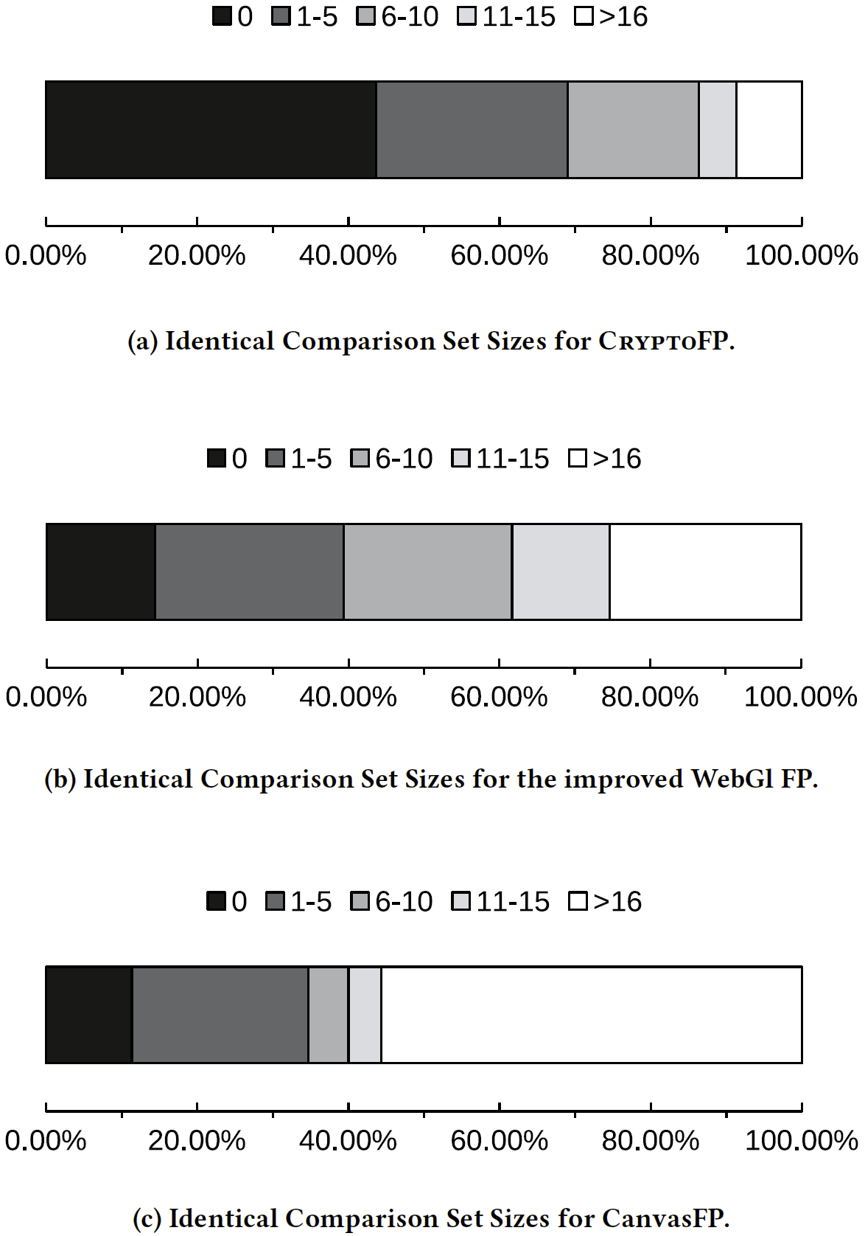
Result
Discrimination Power
- Heterogeneous Scenario

Slide 35
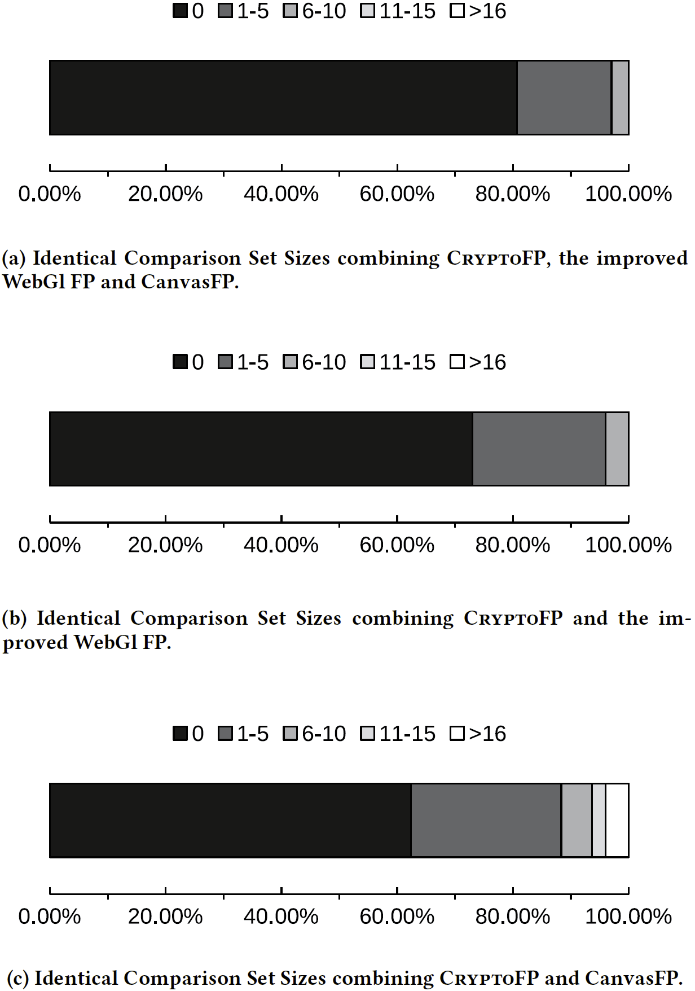
Result
Discrimination Power
- Heterogeneous Scenario
- Combined with other techniques

Slide 36
Result
Discrimination Power (Homogeneous Scenario)
  There is no more details (i.e. graphs, or percentage for each group)
  This result was from the test on the native version (C++ implementation)
  It is even worse in the web implementation. (Again, there is no detail results)
Number of matches |  | Percentages
Group A | Group B
0 | 0 | 18% | 85% | 18%
1 – 58 | 1 – 28
59 – 117 | 29 – 57 |  |  | 67%
118 – 174 | 58 – 87 |  |  | 15%

Slide 37
Result
Efficiency
  Fingerprint generation
    All methods only took a few millisecond, with the exception of WebGL, which took several seconds.
  Fingerprint comparison
    All other methods only require comparison on a hash value.
    CryptoFP needs compare matrices with 200 ms for each pair
      Fast for single comparison
      Very slow if you want to find the target from tons of candidates.

Slide 38
Result
Stability
  Tested by repeating fingerprint generation for three times in each machine.
  All methods correctly generate the same/matched fingerprint, with the exception of audio fingerprinting, which failed 21% of the cases.

Slide 39
Result
Stability (native version)
  Different CPU Load condition
    even with 100% CPU load, the fingerprint was always correctly associated.
    CPU has no effect as long as the function is simple enough.
  Different CPU temperature
    The frequency of quartz crystal will increase with temperature.
    No variations or errors observed.
      Possible explanation: Difference between two closely-located clocks may be too small to affect the result.

Slide 40
Result
Resilience to Evasion
  Only consider techniques implemented by browsers.
  Easiest way for evasion is to reduce the clock precision
    Major browsers already reduced the clock precision, and the negative effect is already shown.
    It is unlikely that the precision will be reduced further.
  User tampering is no in consideration.
    CPU overclocking/underclocking may affect the result.
    Plugins or extensions may easily void the fingerprint.

Slide 41
Result
Resilience to Change
  CryptoFP does not rely on a specific function.
  Reliable way to affect the result it to tamper with the time measurement, which may negatively affect other elements on webpage.
  CryptoFP relies on the functions available in JavaScript.
    There are numerous layers between JavaScript code and the CPU instruction.
    It is impossible to guarantee the code in the lower level will be the same in the long run or from OS to OS.

Slide 42
Reference
Iskander Sanchez-Rola, Igor Santos, and Davide Balzarotti. 2018. Clock Around the Clock: Time-Based Device Fingerprinting. In Proceedings of the 2018 ACM SIGSAC Conference on Computer and Communications Security (CCS '18). ACM, New York, NY, USA, 1502-1514. DOI: https://doi.org/10.1145/3243734.3243796
Device fingerprint, Wikipedia, https://en.wikipedia.org/wiki/Device_fingerprint
Boning, D. S., Chung, J. E., Boning, D. S., & Chung, J. E. (2019). Statistical metrology : understanding manufacturing, (September 1996). doi: 10.1117/12.250817
Bowman, K. A., Duvall, S. G., Meindl, J. D., & Fellow, L. (2002). Impact of Die-to-Die and Within-Die Parameter Fluctuations on the Maximum Clock Frequency Distribution for Gigascale Integration. IEEE Journal of Solid-State Circuits, 37(2), 183–190. doi: 10.1109/4.982424
Caruthers, J. M., Mckay, D. B., Opin, C., Biol, S., Pappu, R., Recht, B., … Gershenfeld, N. (2002). Physical One-Way Functions, 297(September), 2026–2031.
Gassend, B., Clarke, D., Dijk, M. Van, & Devadas, S. (n.d.). Silicon Physical Random Functions, 148–160.
Lee, J. W., Lim, D., Gassend, B., Suh, G. E., Dijk, M. Van, & Devadas, S. (2004). A Technique to Build a Secret Key in Integrated Circuits for Identification and Authentication Applications, 176–179.

Slide 43
Reference
Mowery, K., & Shacham, H. (2007). Pixel Perfect : Fingerprinting Canvas in HTML5.
Englehardt, S. (2014). Online Tracking : A 1-million-site Measurement and Analysis.
Cao, Y. (2017). ( Cross- ) Browser Fingerprinting via OS and Hardware Level Features, (March).

