Slide 1
Pinto: Enabling Video Privacy for Commodity IoT Cameras
Paper Presentation for CMPE 253: Network Security
Feb 15, 2019
Gaoyang Wang Karthik Balakrishna
gwang41@ucsc.edu kabalakr@ucsc.edu

Slide 2
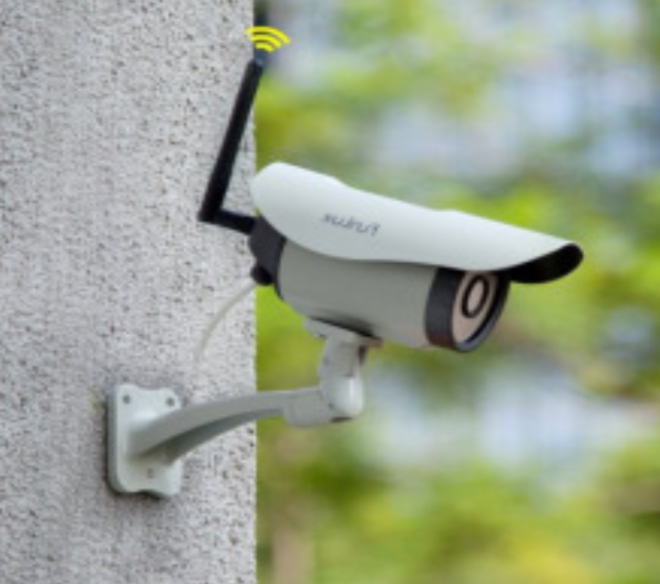
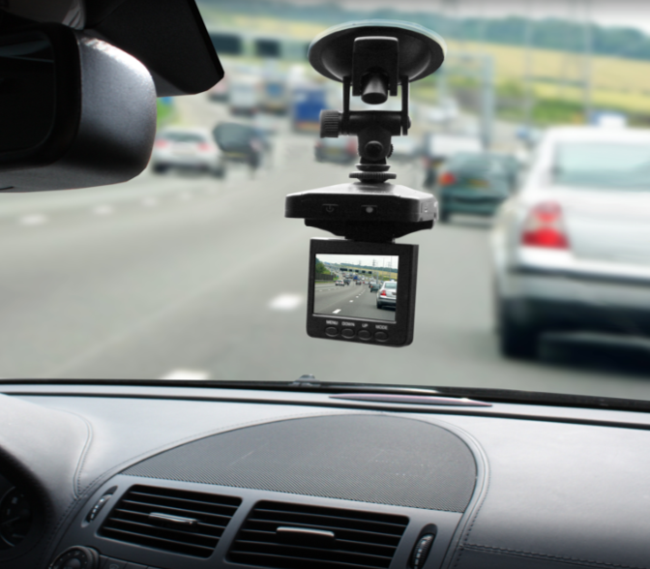
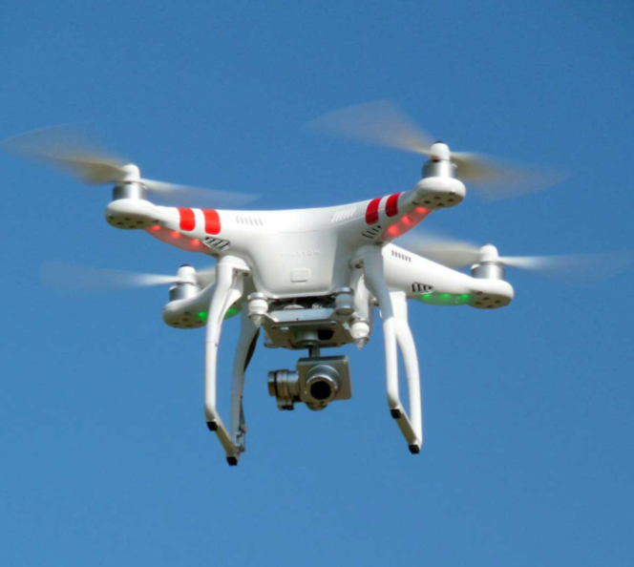
Problem Encountered
Emerging IoT devices Sharing of video evidences
Benefit the public Threat visual privacy
Notes:
So, over the past few years, more and more people have been interested in IoT devices, and they are being used in many situations.
3 examples (on-site security camera, my father’s dash cam, aerial drone camera…)
Pros and cons, respectively.

Slide 3
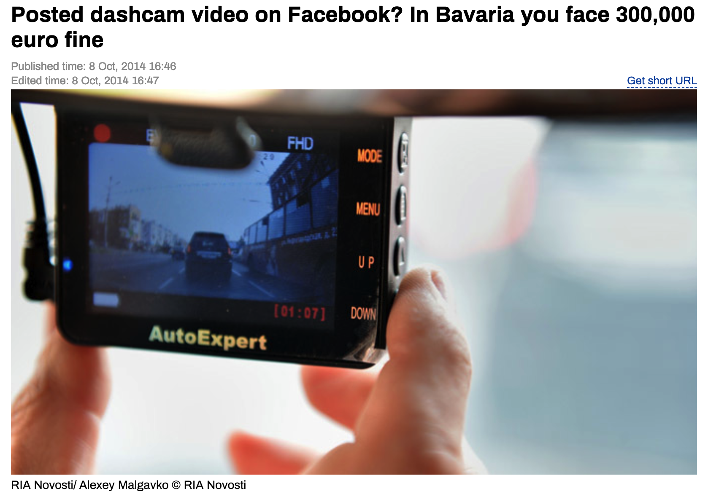
Notes:
In some countries, laws related privacy are very strict. Violation of video privacy in Germany will cost you 300,000 Euros.

Slide 4
Conventional Approaches
Post-blurring:
Able to guarantee visual privacy
Failing to provide video authenticity
Resulting videos have very low frame rate
Video fingerprinting
Useful for video authentication
Poor video quality in simple, low-cost embedded devices
Digital watermarking
Able to verify the integrity of the video
Poor video quality in simple, low-cost embedded devices
Notes:
Conventionally, video owner would blur the video just before publision. Who believes it’s not a fake video? ... … average frame rate 2.3 fps on Raspi;
Video Fingerprinting: Used to recognize videos that have been modified slightly. (Extract characteristics features of a video, then match it against a reference database of copyrighted materials)
Digital Watermarking: Embed hidden info (watermarking) into a video, then use it to verify the integrity.

Slide 5
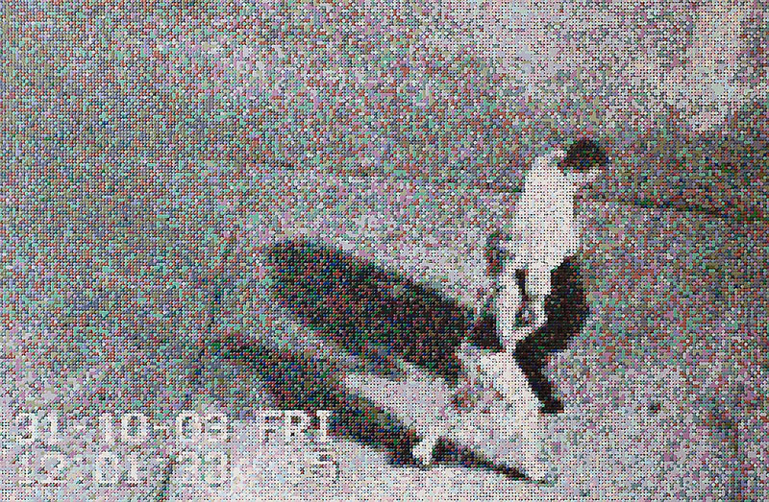
Key Challenges
Limited performance of IoT devices
Posterior fabrication
Content-oblivious hashing
Content Forgery
Notes:
Nullify the signature of the picture.
For real-time blurring, if you want to get the signatures of blurred videos on the fly, the machine that records the video must be a high-end hardware.

Slide 6
Bottleneck of Current Research
Good video evidence should consider the following aspects simultaneously.
Good quality (high frame rates, minimal blurring intensity)
Properly authenticated (time of recording and data integrity)
Consider visual privacy (types of object to be blurred)
Existing research is unable to realize all of them.
Notes:
If you must need a high-quality video with a low-end camera, you cannot use the real-time blurring (low frame rate). How to guarantee the privacy.
Likewise

Slide 7
Solution
Pinto: A software-based solution for producing privacy-protected, forgery-proof, and high-quality videos using low-end IoT cameras.
I.e. The owners release post-blurred versions (privacy-protected) of the video evidences with their original & real-time signatures still valid (forgery-proof).

Slide 8
But How to Guarantee the High Quality?
Videos should have high frame rate.
Minimize blurring intensity and the size of blurred areas while protecting sensitive objects. (To be explained)
Notes:
We will discuss the approach soon. Since we only pixelate without detection in real time recording.
Take example

Slide 9
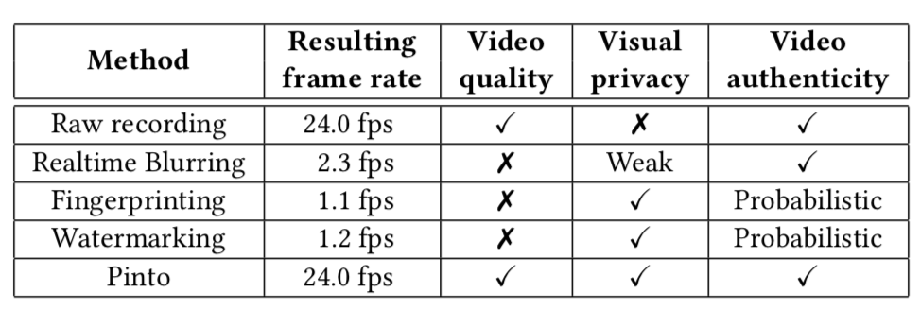
Comparison for Processing A Real-time Video Stream

Slide 10
Design of Pinto

Slide 11
Key Insight 1 -- Decoupled Blurring Procedure
Blurring procedures include:
Observation: Face /car plate detection phase takes much more CPU time (×10^4) than the pixelation phase (0.05ms /frame).
Idea: Pinto performs fast pixelation of entire frames in real time, while deferring the CPU-intensive object detection until necessary for post processing.
I/O time
detect time
Pixelate time
I/O time

Slide 12
Processing Time of Real-time Blurring on a Raspberry Pi

Slide 13
Key Insight 2 -- Block-level Operation
Observation: Each frame can be divided into equal-sized sub-image blocks, pixelation in each block is independent.
Idea: Pinto performs pixelation on:
(1)block-level pixelation on each block (in real time);
(2)blocks of sensitive objects (post-processing for video sharing);
(3)blocks of non-sensitive objects (for verification).

Slide 14
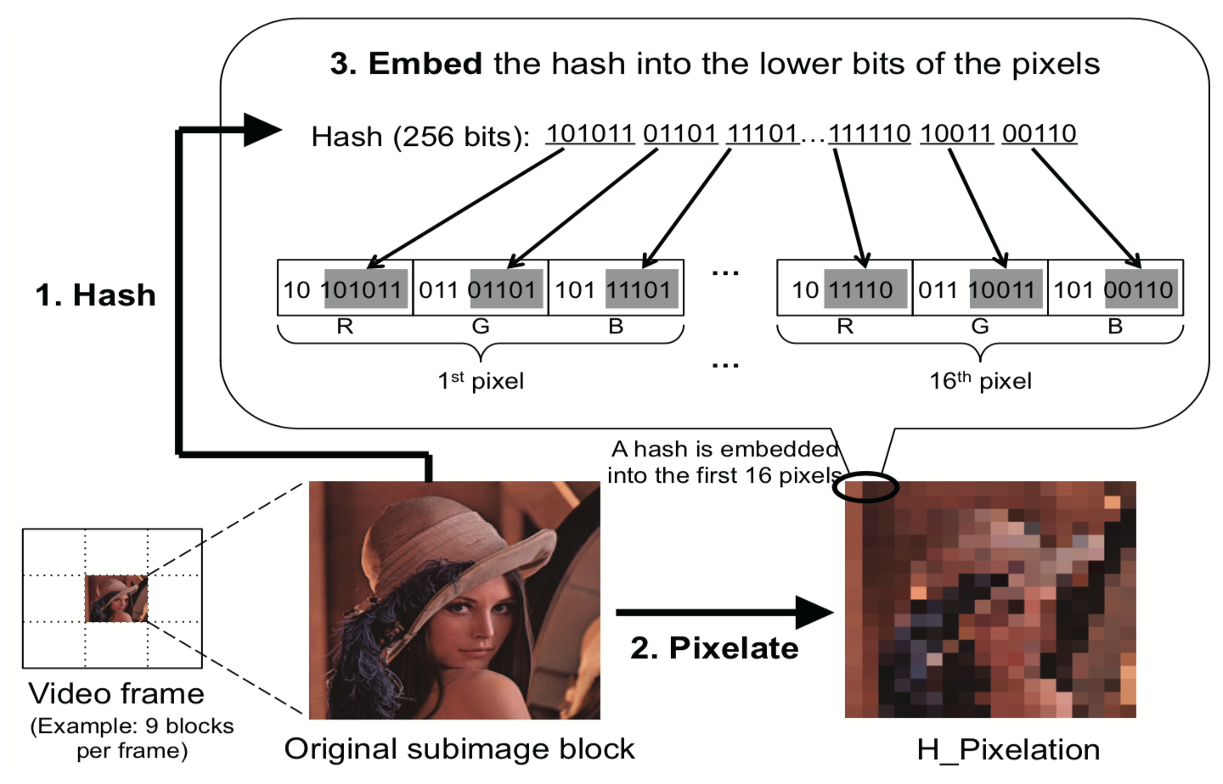
Key Insight 3 -- Forgery-proof Pixelation
Idea: Hash-pixelation (h_pixelation) for both visual privacy protection and forgery prevention.
Notes:
Pixelation combined with hashing! (Hash-pixelation)
So, in such a situation, posterior fabrication would produce different h_pixelation results from the original ones.
To avoid visual jarring, we distribute a 256-bit hash into the “lower” 16 bits of the first 16 pixels in the pixelated sub-image block. We use the least-significant 16 bits (R:6, G:5, B:5) in each of those 24-bit pixels (R:8, G:8, B:8).
It’s infeasible to find a different image that produces the same h_pixelation result.

Slide 15
Framework of Pinto (3 Parameters)
Real-time Processing: p_digest
Performs h_pixelation on all blocks in real time (guarantee video quality and authenticity)
Post Processing: p_profile, p_video
Performs on critical blocks when sharing of a certain video is needed (guarantee visual privacy)
Verification:
Verify the authenticity by checking whether h_pixelation of non-critical blocks (using p_profile) will successfully restore the fully h_pixelated version that is authenticated by its signed p_digest. (guarantee authenticity)
Notes:
只讲三个参数
Camera performs; The resulting h_pixelated video is hashed upon creation, called p_digest. Then sent to a trusted timestamping server.
Indices of critical blocks are logged into a compact form called p_profile;
P_profile is a bit array, where each bit is associated with the block index indicating whether it is a critical block or not.
Block-level h_pixelation of such critical blocks produces a privacy-protected video, called p_video;
3. 根据发布的p_video验证真实性，combine 3个参数.
We can figure out block-level h_pixelation of non-critical blocks by checking its p_profile, to see whether it will successfully restore the fully h_pixelated version, which is authenticated by its signed p_digest. If it can restore, it means no forgery.

Slide 16
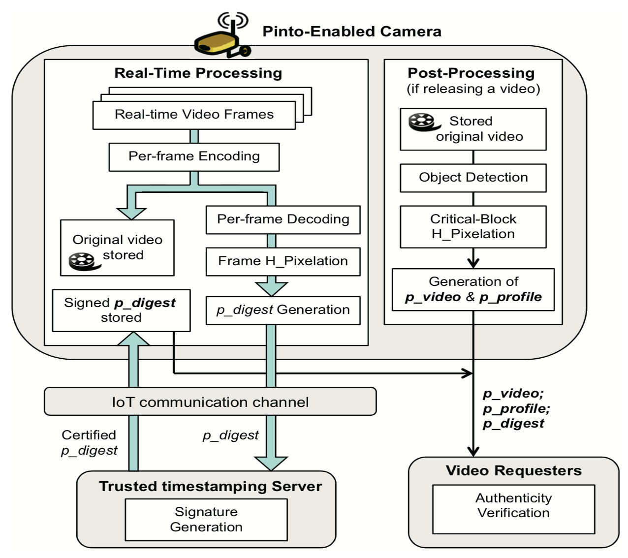
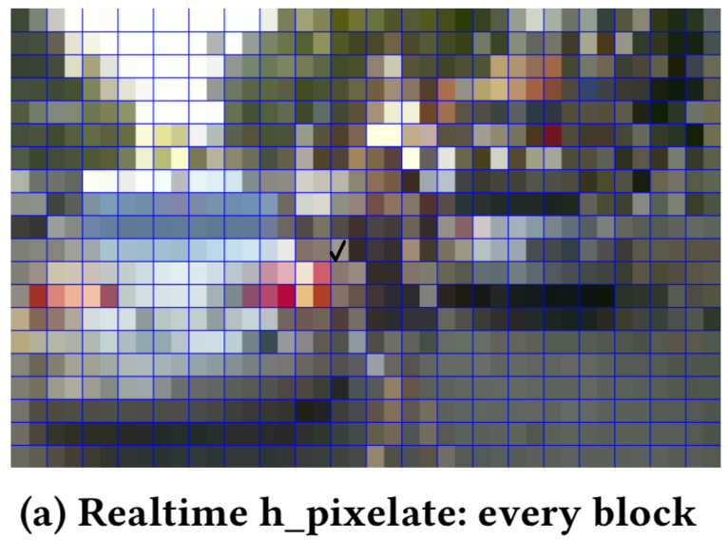
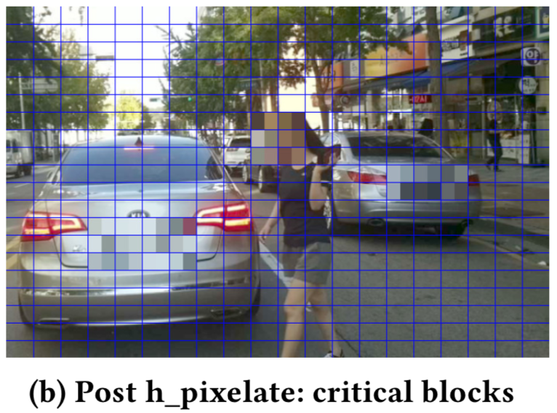
Framework of Pinto
Notes:
前两个是video owner处理的
Verification 是video requester做的

Slide 17
Step 1
Real-time Processing
Notes:
用Professor Qian的例子讲，停车场
The device collectively hashes all per-frame hashes in current 1-min video, and sends it to a trusted online timestamping server.
It deletes those per-frame hashes, and proceeds with frame operations for the next recording.

Slide 18
Step 2
Post Processing

Slide 19
Step 3
Verification of Video Authenticity
Note that Step 3 happens at the video requester side!
Notes:
For video requester, we only need to hash non-critical blocks

Slide 20
Generation Loss
Issue: When using lossy compression, inconsistency between real-time frames and processed versions will happen due to video encoding.
Solution:
MJPEG-based initial compression for video recording
MJPEG-compliant coding for video sharing
Notes:
Real-time, post processing and verification must use the same frame. 压缩视频会导致loss quality, 然后导致不一致。
Initial conversion to offset generation loss.
Each realtime frame captured from camera module is first encoded into a JPEG image.
2.

Slide 21
Two Design Factors in Pinto
Pixelation Intensity (P-scale)
It affects the visual privacy and perceived frame quality.
Ideally, pixelation intensity should be as minimal as possible while de-identifying sensitive objects.
In-frame Block Count (B-count)
It controls the processing speed and video quality.
The in-frame block count should be determined for fine-grained block division while ensuring fast processing speed for producing high-frame-rate videos.
Notes:
The intenser (overly blurred, more pixels combined into one pixel), the poorer video quality, but better privacy.
The fewer blocks per frame, the faster real-time processing, and high frame rate,
However, such coarse-grained block division, i.e., large-sized blocks, results in overly-pixelated p_videos regardless of the actual sizes of sensitive objects in their frames.

Slide 22
Evaluation
Use Case
Effect of Hash Pixelation and its importance
Content Forgery
Visual privacy

Slide 23
Use Case
Pinto aims to provide privacy-protected, forgery-proof, and high-frame-rate videos using low-end IoT cameras.
Sharing surveillance videos
Dash Cam: Protect privacy of bystanders.
Publishing Video Evidence
“People are often willing to release their video evidences to the press or social media, especially when having captured unusual scenes”.
Applicable on Low End devices
Why do any processing on the device itself?
Notes:
I really doubt anyone actually authenticates these videos, how do you even know what is the source?

Slide 24
Hash Pixelation
Effect on Quality
Spreading the hash over the lower 16 bits of only 16 pixels degrades quality negligibly.
Most detail is contained in the Most Significant Bits (MSB), and humans don’t perceive small differences well anyway.
Image with gray 125 left half, gray 124 on right. The difference between the halves may not be detectable.
LSB Embeddings: http://www.eiron.net/thesis/

Slide 25
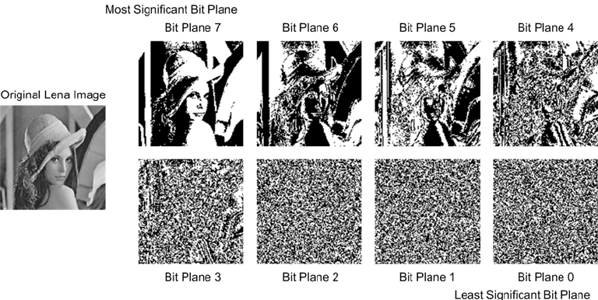

Slide 26
LSB Embedding
Viewing the LSB plane of this stego object reveals its hidden message
LSB Embeddings: http://www.eiron.net/thesis/

Slide 27
Why Hash Pixelation?
Prevents Content forgery.

Slide 28
Content Forgery - Only Pixelation

Slide 29
Content Forgery - Only Hashing
Notes:
They didn’t really explain really explain that, but they say its because
On the other hand, realtime signatures of h_pixelation—which reflect not only original images but also their realtime pixelated versions—preclude the possibility of such pixelation forgery

Slide 30
Content Forgery - Hash Pixelation
Forgery Success Ratio is 0% for all specified forgery types.

Slide 31
Visual Privacy
Types of attacks
Deep Learning based attacks
OCR Based recognition
Parameters Considered
Pixelation intensity
Type of Object (Face, license plate, signage)
Size of Object (in terms of pixels)

Slide 32
Visual Privacy - Deep Learning Based Attacks
R - Ratio goes down as P-Scale goes up.
R - Ratio is better for as size of data set (n) increases.

Slide 34
Visual Privacy - Deep Learning Based Attacks
R - Ratio goes down as P-Scale goes up.
Larger objects (in terms of pixels) are recognised more easily.

Slide 35
Visual Privacy - OCR Recognition
Obviously applicable only to text.
P - Scale of 3 and above seems to be enough.
P - Scale of 12 is recommended to avoid deep learning based attacks.

Slide 36
Video Quality
Frame Rate of at least 12 fps is needed so that motion is perceived properly
Structural Similarity Index (SSIM) is a measure of the perceptual quality. It’s an improvement over PSNR. Another index that could have been used is the Naturalness of Image Quality Evaluator (NIQE).

Slide 37
Block Count Trade Off
Pinto performs much better than Real time blurring.
Increase in block count improves SSIM but reduces Frame rate

Slide 38
A summary of Pinto
The fast, lightweight real-time operation allows video recording at a high frame rate in low-end devices;
The CPU-intensive object detection is executed only when video sharing is needed;
The post processing only permits pixelation for privacy protection;
The post pixelation enables you to determine the degree of visual privacy;
Video processing is done at the camera level, hence not requiring powerful back-end servers;
It is a software-based solution immediately implementable in today’s commodity IoT cameras.

Slide 39
Limitations
P - Scale of 12 chosen, is only valid for 1280 x 720 Resolution.
Limited to MJPEG. Other formats need additional conversion by device/servers.
Limited use cases.

Slide 40
Questions?

