Slide 1
vEPC-sec: Securing LTE Network Functions Virtualization on Public Cloud
CMPE 253 - Network Security
Nitesh S. and Liang W.
Challenger: Li X.
Notes:
So today we are going to present the paper vEPC-sec: Securing LTE Network Functions Virtualization on Public Cloud. I am presenter Liang Wang.

Slide 2
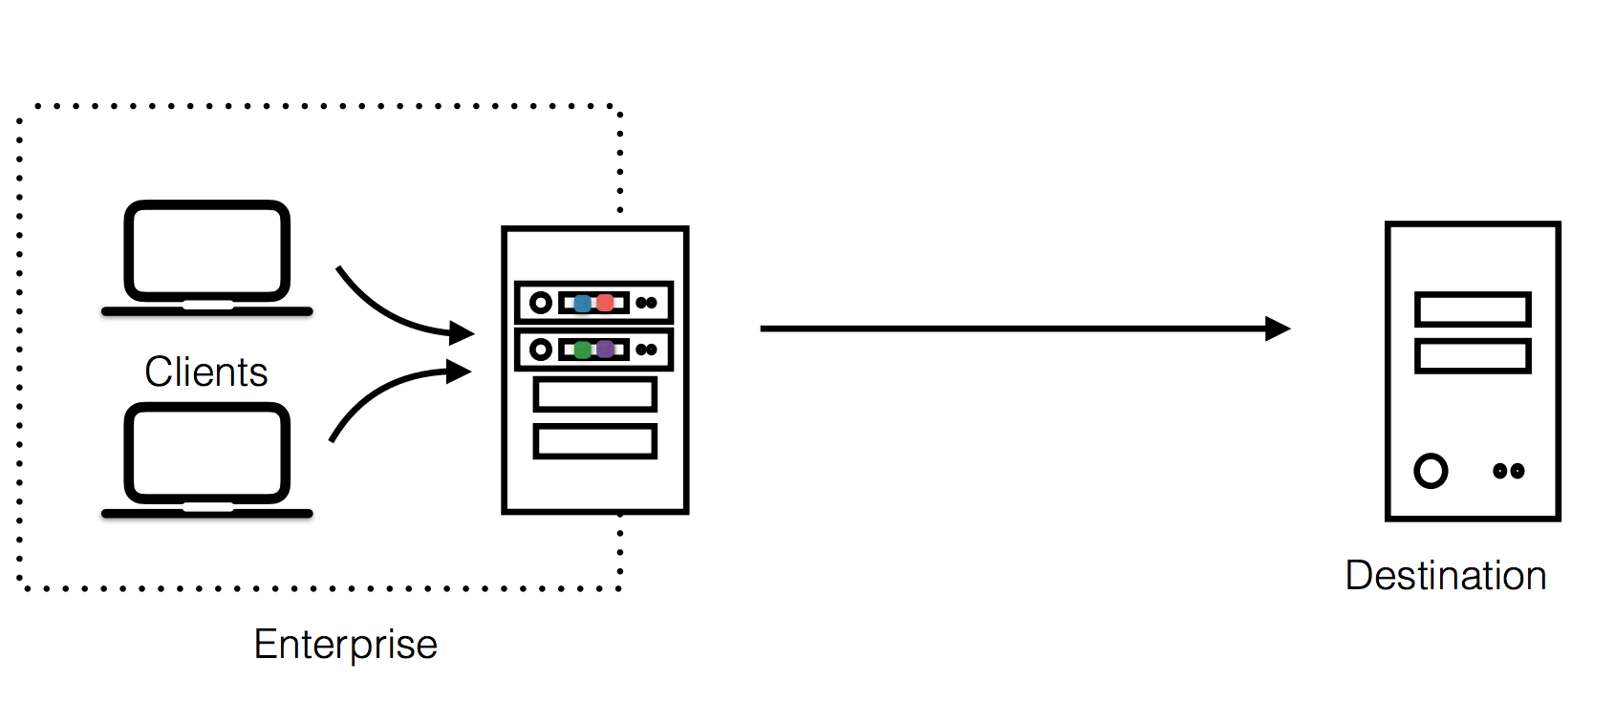
Network Functions Virtualization
Notes:
Before we talk about the content of this paper. We need to understand LTE network function virtualization. So what is network functions virtualization? Modern networks consist of a wide range of appliances that implement advanced network functions beyond merely forwarding packets, such as firewalls, IDSes, web caches, and many more. Traditionally, these network functions are deployed as dedicated hardware devices inside the networks. As illustrated in this picture, network functions are deployed as part of enterprises’ network devices.

Slide 3
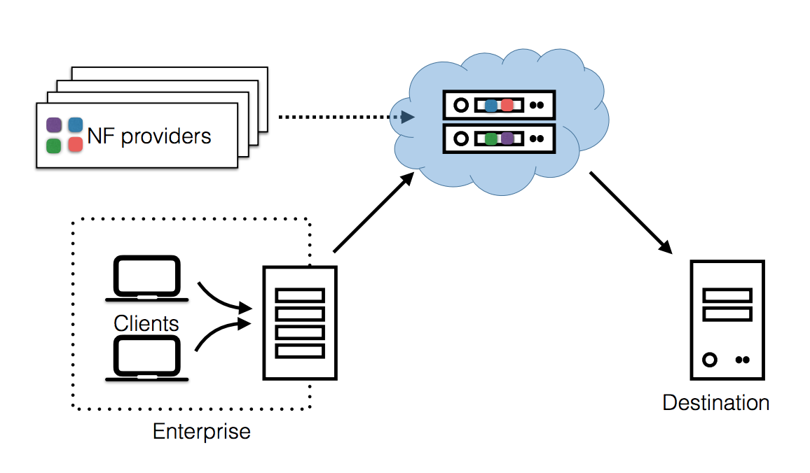
Network Functions Virtualization
Notes:
But in recent years, however, both industry and academia have proposed the replacement of those devices with software implementations running in virtual machines [55,62], a model called Network Function Virtualization (NFV). As illustrated in this picture. Network functions are deployed as cloud service and managed by third-party providers called Network function providers. Such a service model enables enterprises to outsource NFs from their networks entirely to the third-party service, bringing the benefits of cloud computing and reducing costs.

Slide 4
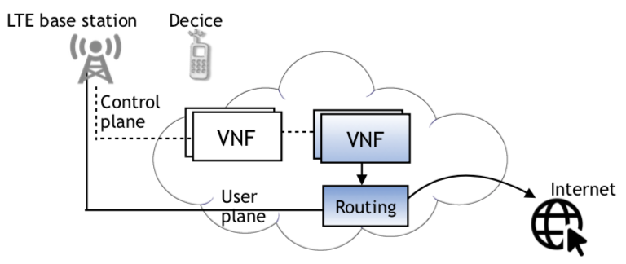
LTE Network Functions Virtualization
LTE: Long-Term Evolution
Commonly marketed as 4G LTE & Advance 4G
Virtualized Evolved Packet Core (vEPC)
Notes:
So LTE Network Functions Virtualization as the name suggests. Meaning outsource network functions of LTE network to public cloud. LTE stands for Long-Term-Evolution, which is a standard for wireless broadband communication for mobile devices and data terminals. LTE is commonly marketed as 4G LTE & Advance 4G. 4G refers to fourth generation of broadband cellular network technology. Here we first give a highly simplified illustration of LTE NFV. LTE network can be divided into two parts, one is LTE base station(formal called eNodeB), radio towers that directly connects to our mobile phones. Base stations form network by themselves, but for simplification, we only draw one station here. Then the LTE base station connects the second part, EPC, Evolved Packet Core, also known as LTE core. It holds the core network functions of LTE network. Here the network functions of EPC are outsourced to public cloud, so we called it vEPC. vEPC can also be divided into two parts, one is control plane, all control messages about LTE network goes though this way. And the another is user plane, also called data plane, user communicate with internet through data plane.

Slide 5
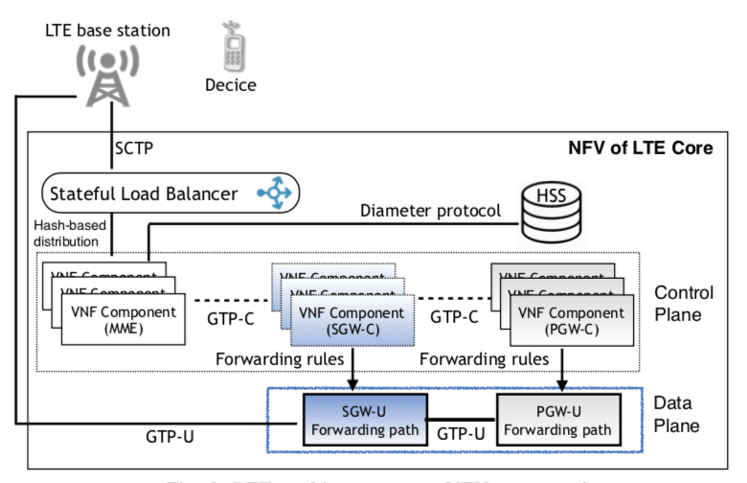
LTE–NFV in a nutshell
Attach Request
Notes:
Now let us zoom into vEPC. Let me briefly explain the structure of vEPC, which is very important to this paper. I am going to explain the structure of vEPC by walking through the attach procedure. The procedure happens when your mobile phone connects to LTE network. So, after your device connects to LTE base station, it will first send attach request to MME. MME stands for mobility management entity, who in charge of all the Control plane functions related to subscriber and session management.

Slide 6
LTE–NFV in a nutshell
authenticates and authorizes
Notes:
Then when MME receive attach request. It will first communicate with HSS. HSS stands for home subscriber server, who in charge of all the user subscription information. So by talking to HSS, MME knows whether this device is legitimate or not. If not, MME will send back attach reject message and terminate the procedure.

Slide 7
LTE–NFV in a nutshell
Create Session Request
Create Session Request
Notes:
If the device is legitimate. MME will create a session for this device on rest of control plane. It will send create session request to SGW-C. SGW stands for serving gateway. Serving gateway is the gateway between the radio networks and vEPC. It has two parts, SGW-C and SGW-U, C stands for control and U stands for user. SGW-C is control part of serving gateway. It generates forwarding rules and passes it to SGW-U. SGW-U is the one who actually in charge of the serving gateway. SGW-C will again create session on PGW-C. PGW stands for packet data network gateway, which is gateway between LTE network and rest of Internet. Similarly PGW-U is the control plane of PGW and PGW-U is the one who manage the forwarding rules. Another thing worth noting is the communications inside EPC, those GTP connection, are not encrypted. But the communication between device and MME, and communication between MME and HSS are encrypted. MME shares a master secret with each attached user device.

Slide 8
LTE–NFV in a nutshell
Got IP and DNS
Attach Accept
Create Session Response
Create Session Response
Notes:
Then after all the sessions are created, MME will reply an attach accept message to user device. At this point, user device receives its IP address and IP of DNS server. And SGW-U and PGW-U will also receive the updated forwarding rules.

Slide 9
LTE–NFV in a nutshell
Access Internet
Notes:
Then user device can communicate with rest of Internet though the data plane.

Slide 10
Vulnerable VNFs selection procedure
Create Session Request
Create Session Request
Notes:
Now we can talk about the vulnerability. In our context, the network functions of EPC are outsourced to public cloud. All the components we mentioned earlier are now VNF, namely virtualized network function, running on cloud cluster. And when MME sends create session request to SGW-C, it is cloud provider’s job to select the best VNF via a procedure called VNFs selection procedure. But, as the author of this paper points out, DNS based VNFs selection procedure is vulnerable. An attacker could hijack the responds to VNFs selection query and therefore manipulate the mapping between MME and SGW-C. And in case there are multiple tenants running their VNFs on same cloud provider. A malicious tenant might be able to associate his malicious SGW-C to other tenants’ LTE network, in which way he can launch various attack to affect victim tenants’ LTE network performance. So under such observation,

Slide 11
Threat Model
Malicious tenant can make his SGW part of other tenant’s LTE network by hijack VNFs selection procedure
Malicious SGW strictly follows LTE standard operations
Notes:
This paper propose such a threat model. First, malicious tenant can make his SGW part of other tenant’s LTE network by hijack VNFs selection procedure. Second, malicious SGW strictly follows LTE standard operations. In other word, malicious SGW cannot be detected by intrusion detection system. Given such a threat model, this paper stands on LTE network carriers’ perspective. Discuss the associated vulnerabilities and how to defend against them.

Slide 12
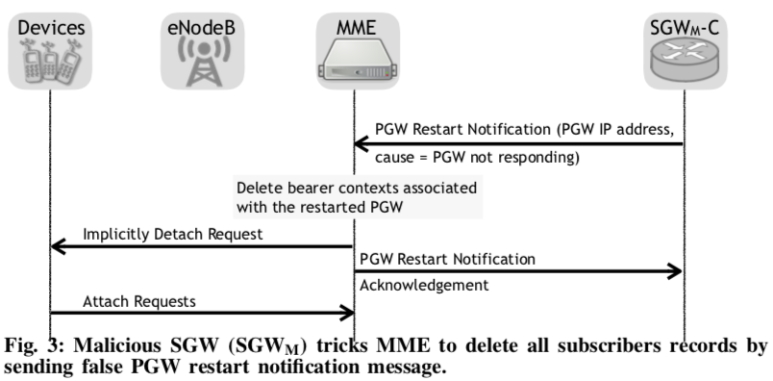
Vulnerability 1: Purging subscribers’ context from MME
Notes:
So under such threat model. This paper identified four kinds of vulnerabilities. First, is the malicious SGW-C can purging subscribers’ context from MME by sending MME the PGW restart notification. As illustrated in this picture. PGW restart notification is a message sent by SGW indicating a PGW associated with sender SGW is unreachable. Then upon receiving PGW restart notification, MME will detach all devices associated with that PGW. Then these devices need to resend attach requests to MME in order to reassign PGW for them.

Slide 13
Vulnerability 1: Purging subscribers’ context from MME
Result:
All devices associated with a PGW get disconnected temporarily.
Massive reconnection cause incast micro-burst at cloud.
Notes:
As a result, this vulnerability can cause network interruptions to user devices. Which will heavily impact user experience. And also massive reconnections will cause incast micro-burst at cloud. Which might also affect network performance.

Slide 14
Vulnerability 2: Device master key exposure
Master key is passed around MMEs in plain text when user moves.
Master key can be sniffed by malicious SGW
Notes:
The second vulnerability identified in this paper is about master key exposure. As I mentioned before the communication inside EPC are not encrypted, so malicious SGW can sniff all the traffic going inside the vEPC. Although MME to device connection and MME to HSS connection are encrypted. But there is a design in LTE that allows user device to move from one place to another, change its associated MME without break its connection to Internet. Such design is made possible by allowing old MME to handover device master key to new MME. And that handover message is sent in plain text. So malicious SGW can sniff device master key from that message. As shown in this picture, paper’s author successfully sniff device master key using wireshark.

Slide 15
Vulnerability 2: Device master key exposure
Result:
Ciphering/deciphering user’s radio packets
Many more...
Notes:
As a result, if attacker obtain device master key. He will be able to derivate all keys needed to ciphering/deciphering user’s radio packets. So attacker can intercept all the communication between the target device and LTE network control plane. With that capability, attacker can do lots of thing.

Slide 16
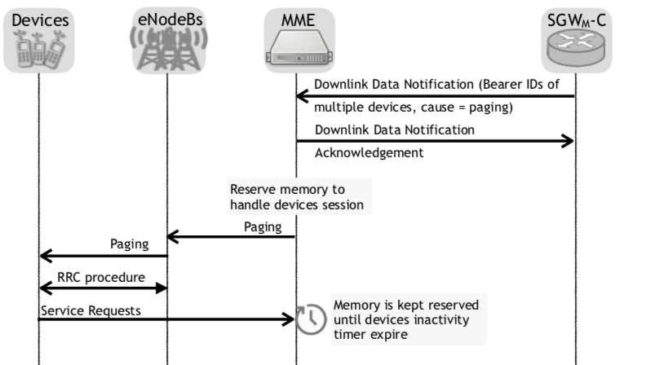
Vulnerability 3: Increase memory pressure on MME VNF
Notes:
In the third vulnerability, as illustrated in this picture. Malicious SGW-C can make MME allocate memory for devices session via downlink data notification message. Downlink data notification message is part of the network triggered service request procedure. So when there is data sending from Internet to user device and user device is in idle state. A downlink data notification message sent from SGW will trigger user device switch from idle state to connected state. And also trigger MME to allocate memory for this new session. Malicious SGW can fake this message repeatedly, therefore waste MME’s memory constantly.

Slide 17
Vulnerability 3: Increase memory pressure on MME VNF
Result:
Waste victim devices battery power
Waste victim tenant’s hardware resource
Notes:
As a result, fake downlink data notification message not only waste victim tenant’s hardware resource. But also falsely put victim devices into connected state. Mobile device will consume much more energy in connected state than in idle in order to perform long range communication with LTE base station. Therefore this vulnerability will also waste victim devices battery power, causing significant impact on user’s experience.

Slide 18
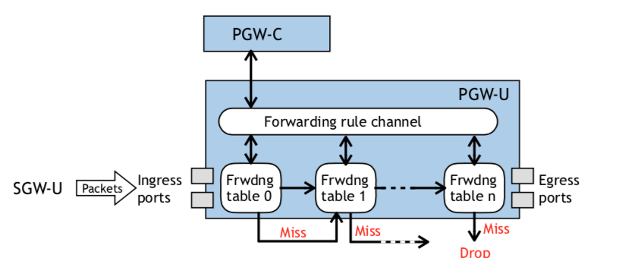
Vulnerability 4: Slowing GTP forwarding plane
Injecting fake IP packets
Notes:
At vulnerability 4, malicious SGW-C can slow down PGW’s packet forwarding speed by injecting fake IP packets. Normally, if you inject fake IP packets at user side, these packets will be filtered by serving gateway. And since each PGW is associated with multiple Serving gateway, it cannot impact other users’ experience. But for malicious SGW-C, it can first install several forwarding rules on SGW-U to allow fake IP packets to pass though serving gateway. Farther more, benefit from that fact that PGW-U only drop packet if it matches none of the forwarding tables. A small amount of fake IP packets that miss all forwarding tables can consume PGW’s processing power significantly.

Slide 19
Vulnerability 4: Slowing GTP forwarding plane
Result:
Increase network latency
Overbill user
Notes:
As a result, the performance of PGW is affected therefore reduce user’s Internet access experience. Also, those fake IP packets is still considered to be part of users’ traffic. If the victim user is using a charge by traffic service, he will gets billed for those fake traffic.
Ok, these are 4 vulnerabilities identified by this paper, now it’s time to talk about the solution provided by this paper.

Slide 20
Solution: Add vEPC-Sec security module
vEPC-Sec: Distributed Key management scheme to GTP-C traffic.
Major Goals:
Ciphering and integrity protection to LTE control-plane messages
Prevent fake IP packet injection into user-plane
Specifically:
GTP-C ciphering and authenticity
GTP-U faithful packets forwarding: (Prevent IP packet injection)
Notes:
We have till now seen how LTE network works, what are the different vulnerabilities that the paper talks about. Let’s focus our attention to the solutions/ countermeasures offered by the paper to tackle attack in inside of LTE network.

Slide 21
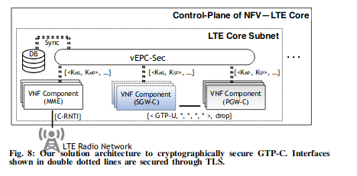
Architecture
Central entity for providing key management to GTP-C
traffic.
All components interact with VNF via dotted secure interface
Target GPRS tunneling protocol communication
Notes:
LTE EPC VNFs derive ciphering and integrity keys to encrypt and integrity protect messages. One of the VNF is chosen by stateful Load balancer to serve requests and act as peer VNF for other VNFs. GTP is GPRS tunneling protocol used for communication between SGW-PGW, SGW-MME and SGW-LTE base station.

Slide 22
Flow of Operation in vEPC-Sec
EPC VNF is selected to serve the subscriber, it connects with vEPC-Sec over secure interface.
Request message to vEPC-Sec includes VNF identities of VNF with which it want to communicate.
vEPC-Sec contacts local DB to check if all requested VNF are part of same tenant/operator.
If positive, KDF generates 3 pairs of keys so that MME, SGW, PGW VNFs can independently communicate. Kmp, Kms, Kps keys generated.
Response by vEPC-Sec includes key pairs, encryption and integrity identity required for derivation of cipher and integrity key later by individual VNF.

Slide 23
Legitimate data packets are transferred from SGW to PGW

Slide 24
Solution in detail
LTE GTP-C confidentiality and integrity protection:
Distributed security keys derivation and management for GTP-C
First VNF checks whether it has the symmetric keys to interact with other VNFs or not.
If Yes, subscriber signalling messages are ciphered and integrity protected. Otherwise shared key retrieved over TLS connection.
Key information Request Message including VNF identity (UUID) as well as other VNFs.
All VNF to same operator
vEPC-Sec computes Kms, Kmp, Ksp to secure communication.
How these keys are derived ?

Slide 25
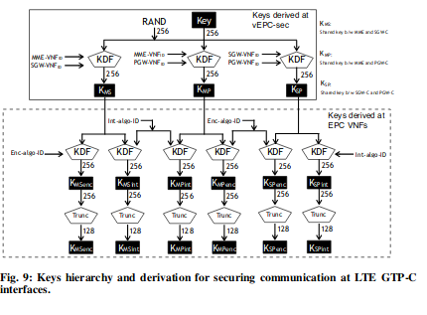
Key Information Response message
Response
Message has Encryption and Integrity algorithm identity
Key Allocation Request Message to VNFs
Notes:
Truncated to 128 least significant bits keys.

Slide 26
Securing communication during device mobility
Secure communication between MMEs and MMEt at the time of LTE S1 handover procedure and sharing Kasme key between MME’s from different tenant.
Steps performed:
MME source receives handover required message from LTE base station.
MME source determines address of MME target and asks vEPC-Sec to provide Kmm for secure communication with MME target.
vEPC-Sec gives it to MME source along with ciphering and integrity identity
vEPC-Sec also sends Handover Key establishment to MME target including Kmm and identity
Handles vulnerability 2 because Kmm shared via ciphered and integrity protected message

Slide 27
Solution
B. LTE GTP-U faithful packets forwarding
vEPC-sec ensures SGW-U does not inject any fake packets
Forwards data packets without delaying
Does not duplicate packet forwarding

Slide 28
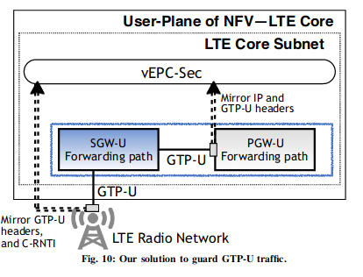
PGW-U and SGW-U apply identical firewall rules.
SGW-U forwards packets acc. to data forward policy to PGW-U
Both apply identical packet forwarding rules.
Vulnerability 4 arises since SGW-U forwards fake IP packets and exhausts table lookup
SGW-U and PGW-U policies never mismatch
Making SGW-U firewall for PGW-U
Notes:
At the time of device registration, PGW-C VNF assigns device IP address and applies packet forwarding rules at PGW-U. No use case scenario where SGW-U and PGW-U policies mismatch.

Slide 29
Prevent overbilling of the subscriber/ Ensure Data Packets are not maliciously throttled
Enable data packet header inspection at vEPC-Sec
LTE base station adds GTP-U header that includes GTP-U tunnel identifier, message type and packet sequence number(uniquely identifies packet number in IP flow)
Enable 1:1 mapping between packets sent by LTE base station to SGW-U and the ones received by PGW-U from SGW-U.
Looking at same headers reported from two different entities, vEPC-sec can distinguish any missing packets, out of order packets and duplicate packet.
This approach isolates the malicious activity done at SGW-U.
Notes:
With solution B, fake IP packets injection is prevented. There is another way in which malicious SGW-U can misbehave. It can replay legitimate data packets to overbill the subscriber and can delay the data packets forwarding to throttle the end user throughput.

Slide 30
Handle Vulnerabilities
How vEPC-Sec addresses vulnerability 1 and vulnerability 3 ?
MME only accepts integrity protected and ciphered messages from PGW-U (sent via SGW-U) using derived shared keys between MME and PGW VNFs.
Hence, SGW-U can’t lie that the message is originated from PGW-U.

Slide 31
Address Master key exposure during device intra-system switch vulnerability 2
vEPC-Sec prevents exposure of master key by transmitting it over encrypted GTP-C traffic between MME(source) and MME(target) using Kmm key derived from vEPC-Sec.
Notes:
We have already seen in the architecture of vEPC-Sec that it provides distributed key management scheme for interaction between different VNFs. vEPC-Sec provides Kmm key for interaction between MMEs and MMEt.

Slide 32
Address Vulnerability 4
Assigns the default packet forwarding policy to drop the packet
As a result, SGW-U only allows those IP packets whose address assigned by PGW-C
Assign role of firewall

Slide 33
vEPC-sec Security Analysis
Whether an adversarial VNF can get the shared symmetric keys to communicate with victim VNFs?
Whether an adversary can abuse PGW-U resources by injecting fake packets?
Whether the attacker can limit the victim subscriber’s package rate ?
Notes:
This is the only form of evaluation that the authors have done in the paper. They have analysed the security of their architecture from an attack by adversary.

Slide 34
Secure communication between malicious and victim tenant VNFs
Assume an adversary model where adversary can communicate with vEPC-Sec to derive keys.
Adversary can get the UUIDs of victim’s peer VNF and send a request to vEPC-Sec to derive keys using keys information request message.
Adversary includes UUID of its VNF as well as victim MME and PGW UUID.
vEPC-Sec first verifies whether they are of same tenant or not.
vEPC-Sec contacts cloud database to get the answer which has mapping of VNF, ids, location etc.
From the reply from cloud database, vEPC-Sec determines that all 3 VNFs do not belong to same tenant or operator.
Hence, vEPC-Sec rejects request by sending Keys Information Request Rejected message back to malicious SGW.
As a result, malicious SGW cannot get secure symmetric key from vEPC-Sec.

Slide 35
B. Detect fake IP packets injection by SGW-U
Assume an adversary model where an adversary is allowed to inject fake IP packets which is against the policy provided by PGW-C.
When these fake IP packets arrive at PGW-U they are marked as abuse attempt packets since no forwarding table entry exist against these fake IP packets.
PGW-U informs PGW-C which takes action after contacting NFV orchestrator.

Slide 36
C. Illegal throttling of data packets
Adversarial control attacker receives packets from LTE base station and delays their forwarding to PGW-U.
PGW-U mirrors packet headers to vEPC-Sec.
vEPC-Sec checks 1:1 mapping of packet sequence numbers that it has received from LTE base station and PGW-U.
If sequence number mismatch is consistently observed, it raises alarm towards NFV orchestrator.
Hence, Malicious tenant is removed.

Slide 37
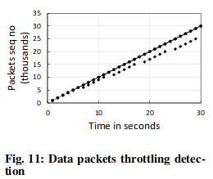
Brief Performance evaluation of vEPC-Sec
How quickly vEPC-Sec determines throttling of data packets.
Difference in packet sequence number arriving from base station vs PGW-U.

Slide 38
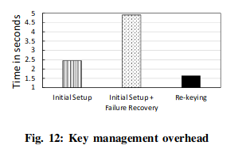
2. Key management Overhead
Machine with 2.5 GHz and 3GB RAM.
Additional overhead of 2.5 seconds only.
Rekeying process has the least overhead.
After every failure, new shared symmetric keys needs to be generated.

Slide 39
Conclusion/ Comments
vEPC-sec secures inside of LTE networks
Security analysis shows that they are able to achieve good performance
More experiments could have been performed.
Prerequisites was to understand lot of LTE network terminology.
Questions ?

